Slide 1

Dorsal Veins Cancelable Biometric Authentication System
Faizanur Rahman
Manish Kumar Vyas
20/ Nov/2018

Slide 2
Agenda
Introduction To Biometric Authentication System
Existing System and Their Limitations.
Why We Chosen Dorsal Veins
Dorsal Hand Vein Extraction
Image Segmentation Method
Finding Edge Method
Maximum Curvature Method
Template Transformation And Classification
Cancelabilty
Flow Chart of applied cancelablity
Classification And Results
Demo of Implementation of the Full Authentication System

Slide 3
What is Biometric Authentication ?
Biometric authentication is a process that depend on the unique biological characteristics of an person to verify his identity.
Biometric authentication is most effective and secure authentication system because biological information of a person is unique and it is difficult to transfer from one person to another.
In biometric authentication, biometric information of a person is captured and match to the stored data in the database. If both the data(captured and stored) match then authentication confirms.

Slide 4
The problem or challenge with existing Biometric Authentication System
Being a great way for unique identification they also pose a threat of being compromised. They can be leaked and hacked.

Slide 5
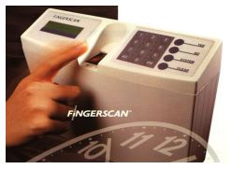
Fingerprint Biometric
Fingerprints can be copied from glass pannel of device.
Hacked using Gummy Bear Fingerprints.

Slide 6
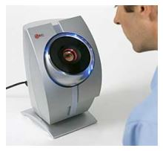
Retinal Scanner Biometric system
Ratina can be damage because continues use of rays.

Slide 7
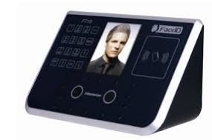
Facial Recognition
Facial biological information can be lost in accidents(like burning face)
One can use plastic surgery for hacking purpose

Slide 8

Why Dorsal Veins for Biometric Authentication ?

Slide 9
Dorsal Veins Are-
Unique pattern for indivusuals
Novel biometric features
Secure and very difficult to forge
Tells us about the liveliness of the person
Can’t hacked and copied.

Slide 10
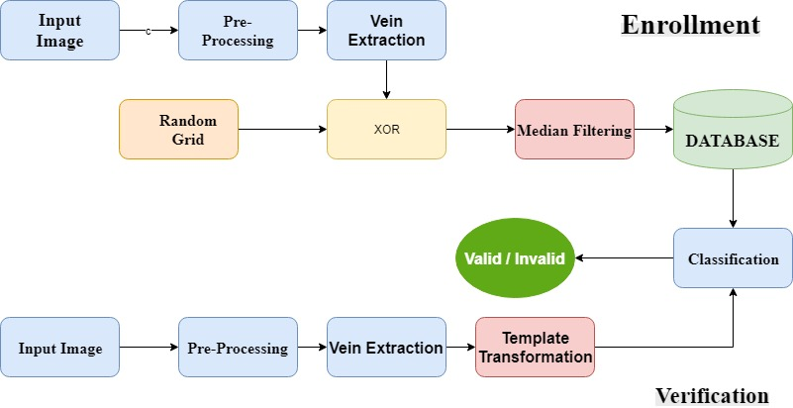
Proposed Solution for the Authentication System

Slide 11
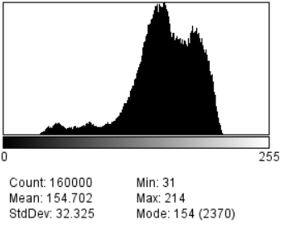
Infomation About the Dataset
We have used high-resolution data set contains images of 400 × 400 pixels, with 850 images split into 85 classes, giving a total of 10 samples per class. This data set contain of thermal image of dorsal hand vein image.

Slide 12
Dorsal Vein Extraction Methods
We have used various methods for Vein Extraction
Image Segmentation Using Statistical Approach
Finding Edge Method
Maximum Curvature Method
Vein extraction is performed to get the features from the biological information.

Slide 13
Image Segmentation Using Statistical Approach
In hand image have 3 region. skin, dorsal veins and hairs. For detecting these three segment we have to calculate the conditional probability of each region.
Since our image data-sets have uni-model distribution of gray level, so parzen estimated conditional probability of these three segments is overlap. Due to overlapping zones in the conditional densities the classifier error rate is unacceptable large.

Slide 14
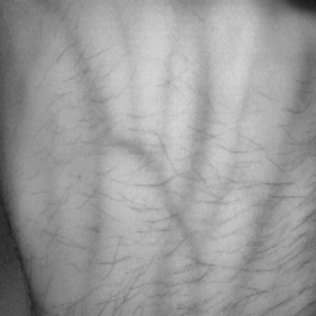
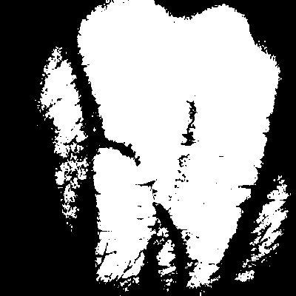
Results Of Grey Level Thresholding
Original Image (b) Applied Grey level Thresholding

Slide 15
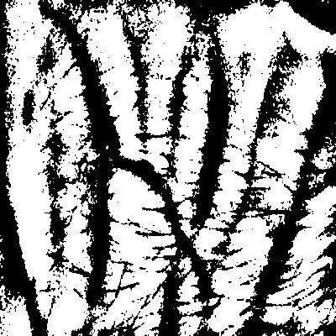
Results Of Adaptive Thresholding
Original Image (b) Applied Adaptive Thresholding

Slide 16
Vein Extraction Using Finding Edge
This method of edge detection is same as the line detection
We locate points in the image plane where the image data is significant discontinuous.
Points of these locations are called edges or edge elements.
ine detection in which each operator consists of two or more templates with which the input image is convolved

Slide 17
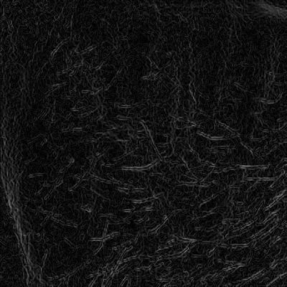
Results Of Finding Edge Method
Original Image (b) Applied Finding edge Method

Slide 18
Preprocessing:Hair Removal
Above two method didn’t extract the proper pattern dorsal vein pattern, because of the presence of the hairs. We performed the hair removal step on the original image to get good pattern of veins.
We performed image smoothening by using mexican hat filter for the hair removal process. Which given a very good results as shown in images.
This plugin applies a Laplacian of Gaussian (Mexican Hat) filter to a 2D image.

Slide 19
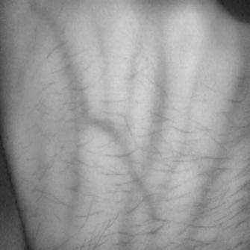
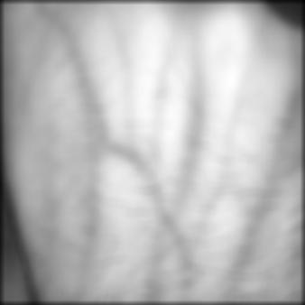
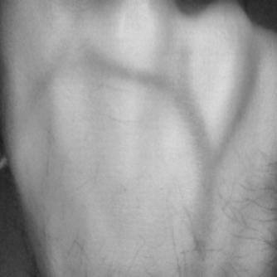
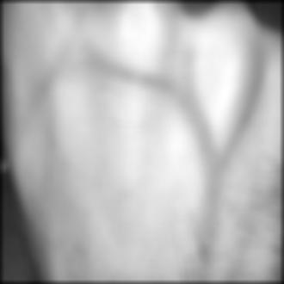
Results of Preprocessing
Hair image b) Removed hair image

Slide 20
Method used for
Vein Extraction
Steps Of Maximum Curvature
Extraction of the center positions of veins.
Connection of the center positions.
Labeling of the image.
This Method given us the desired vein pattern extraction

Slide 21
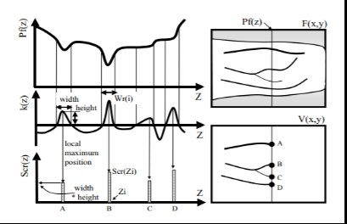
How Maximum Curvature profile look like

Slide 22
Calculation of center of profile
Lets take a 1-D profile and calculate height and width of valley based on above step.
profile = 0 1 2 3 4 5 4 3 2 1 0 -1 0 0 1 2 5 2 2 2 1
Thres_profile = profile > 0
Thres_profile = 0 1 1 1 1 1 1 1 1 1 0 0 0 0 1 1 1 1 1 1 1
1 - shift 0 1 1 1 1 1 1 1 1 1 0 0 0 0 1 1 1 1 1 1 1
difference 0 1 1 1 1 1 1 1 1 1 0 0 0 0 1 1 1 1 1 1 1 (-) -----------------------------------------------------------------------------------------------------------
X 1 0 0 0 0 0 0 0 0 -1 0 0 0 1 0 0 0 0 0 0 X
starts = where difference is greater then 0(1,14).
ends = where difference is less then 0(10).

Slide 23
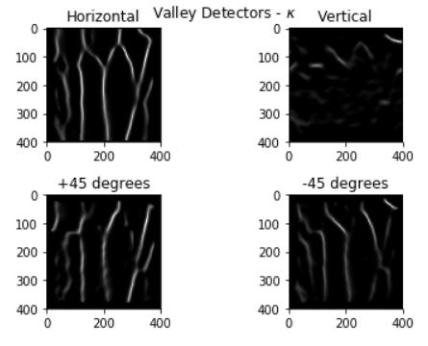
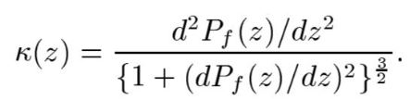
Calculation of Valleys using Kappa Function

Slide 24
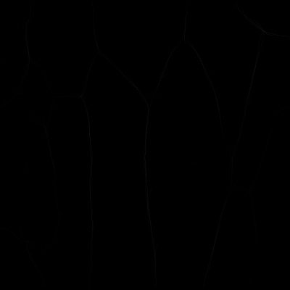
Result of Assignment of Score to the center Position

Slide 25
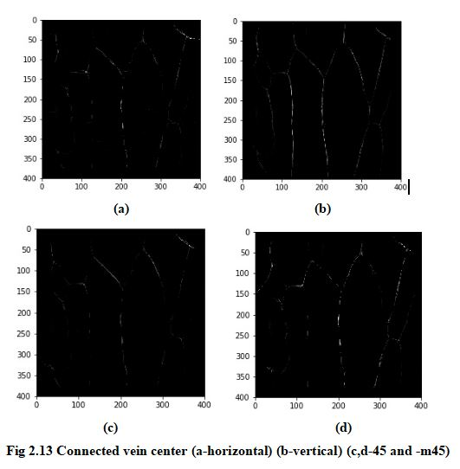
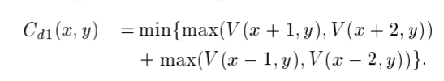
Connection of vein center:
After calculating profile in all direction
At apixel (x,y). Maximum

Slide 26
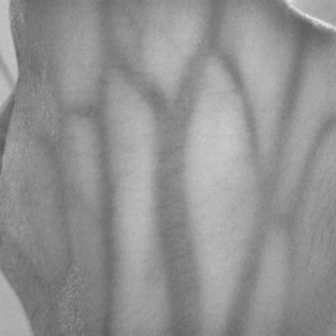
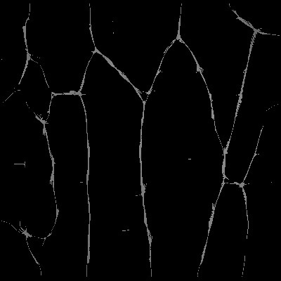
Labeling the Image
Extracted vein pattern is binarized using threshold. Median is calculated, at any pixel(x,y), using scores of profile in all the direction. The pixel is replaced by the calculated median value at that pixel
If median is smaller than the threshold then it is the part of the background and if the value of the median is larger or equal to the threshold than median is part of the extracted vein pattern.

Slide 27
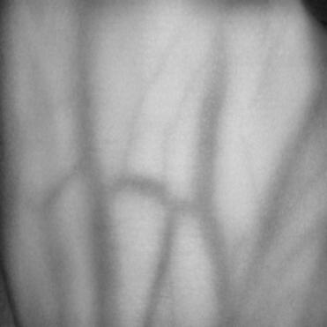
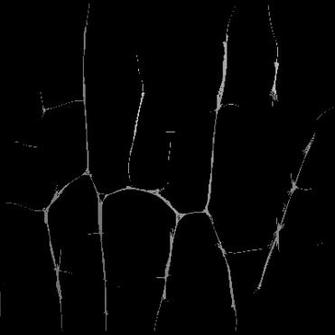
Some More result of Maximum Curvature Vein extraction

Slide 28
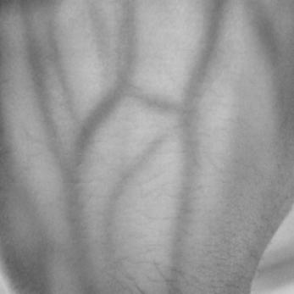
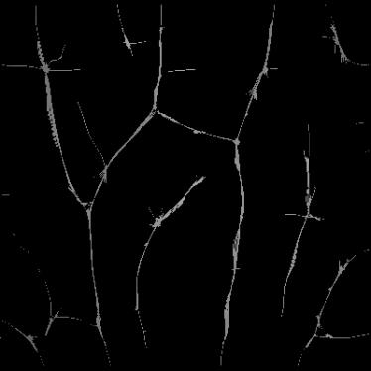

Slide 29
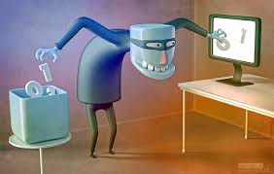
Template Transformation
These systems have been repeatedly hacked using technique like database attack. Therefore, we are trying to develop a biometric identification system based on the idea of “cancelable Biometrics” using a template protection approach generating binary features which are revocable.

Slide 30
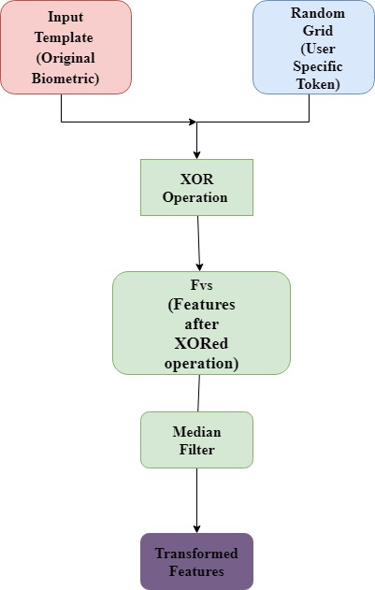
Cancelabilty
Cancelabiltiy is applied on the data set to provide extra security.
2 level distortion is done on the dataset by applying XOR and Median filtering on the original features.
Once a database is hacked we can change template and can revoke the features.

Slide 31
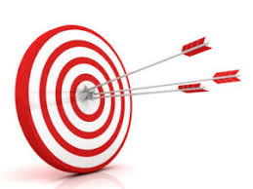

Classification
And
Result

Slide 32
Classification And Results
Evaluation of performance parameters has been performed on transformed features, on the database of 850 images (85 subjects which having 10 samples each) is divided as 2 images for testing and 8 images for training.
True Positives (TP): Actual class is positive and we predicted positive and as well. True Negatives (TN): Actual class is negative and we predicted negative as well. False Positives (FP): Actual class is negative but we predicted it positive, False Negatives (FN): actual class is negative and we predicted negative
False Acceptance Rate = FP / (FP+TN)
False Recognition Rate = FN / (FN+TP)

Slide 33
Classification Experiment
data
93%
KFA Classification is applied to check the applicability of the proposed method
80%
22
15
Worst
Case
Best
Case
Accuracy in Best, Average and Worst case is shown

Slide 34
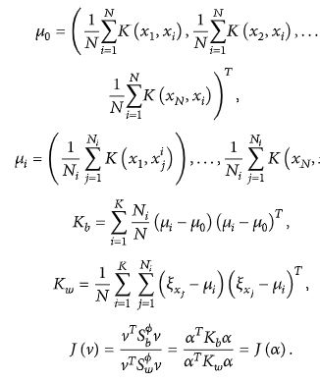
We Have
J(v) - as a cost function,
Kw - Within-class scatter matrix
Kb - between-class scatter matrix
We tried to optimize the cost function by such that Kb is maximize and Kw is minimize.

Slide 35
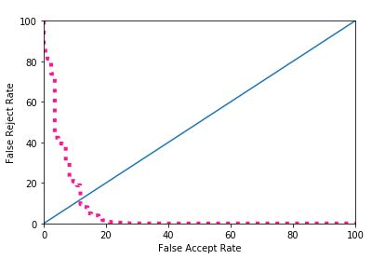
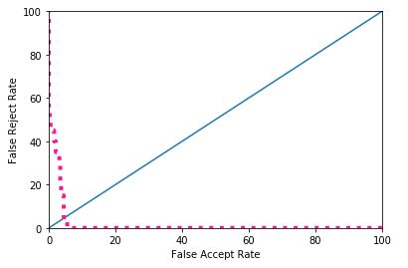
Result of the Best Case shown Below
Result of the Worst Case shown Below

Slide 36
Conclusion
After Sucessfully extraction of dorsal veins and applying non-invertible transformation techniques we are performing training and testing on dataset along with and various performance evaluation parameters show that the templates which generated are non-invertible, we can revoked these templates easily and are performing well. The proposed technique based on cancelable biometrics has been tested and it is delivering the good resul.

